Slide 1
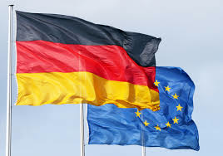
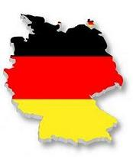
Our Country of the month
is……
Germany

Slide 2
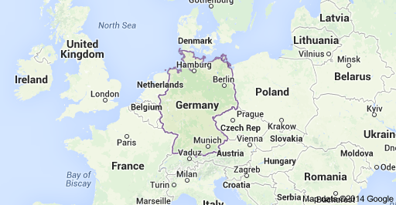
Germany is part of Europe
Where is Germany?
Germany lies in the center of Europe and shares borders with 9 countries: - Belgium, Netherlands, Denmark, Poland, Czech Republic, Austria, Switzerland, France and Luxemburg.

Slide 3
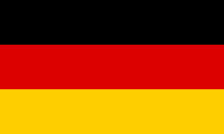
The German Flag is black, red and gold.
82 million people live in Germany (2012)

Slide 4


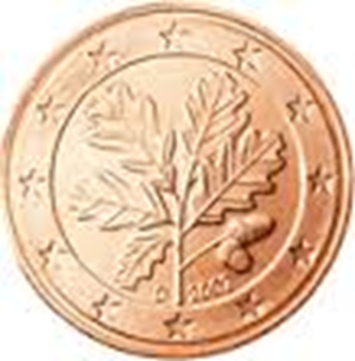
Germany’s National Coat of Arms
The coat of arms of Germany displays a black eagle on a yellow shield.

Slide 5


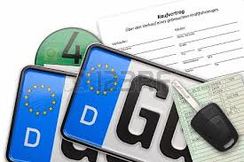
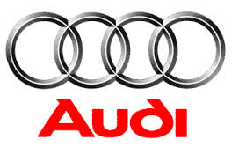

Germany makes lots of Brands of cars. Can you recognise their logos?
Q - Why does the German number plate have a D on it?

Slide 6
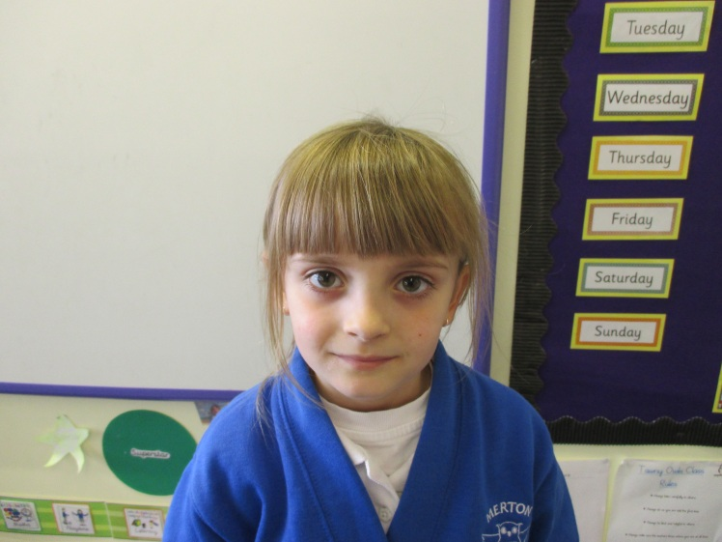
Julia’s Father comes from Germany and they can both speak German
They are going to help us to learn a few words in German.

Slide 7
The language spoken in Germany
is German( Deutsch)
Hello – Hallo
Good morning – Guten Morgen
Good afternoon – Guten Tag
Goodbye – Auf Wiedersehen
Please – Bitte
Thank you – Vielen Dank

Slide 8
When you are speaking to an adult you refer to them as:
Mrs = Frau (James, King, Epstein)
Miss = Fräulein (Smith, Scott, Logan, Fellhauer, Bennett)
Mr = Herr (Cullington, Lawrence).

Slide 9
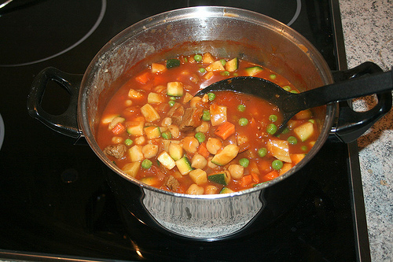
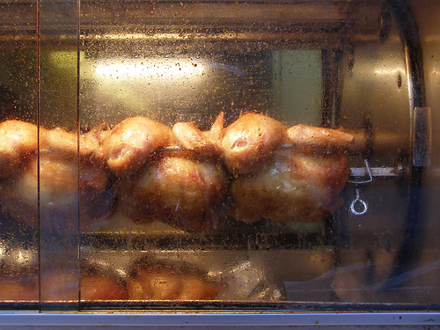
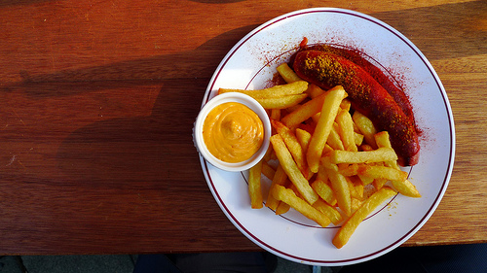
Traditional German foods
Eintopf ( meaty soup pot)
Broiler (roast chicken)
Wurst (sausages)
Rostbratwurst mit pommes
oder Sauerkraut.

Slide 10
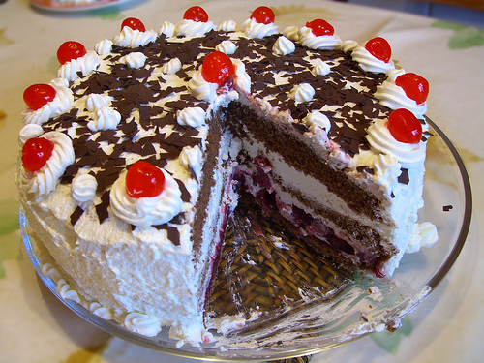
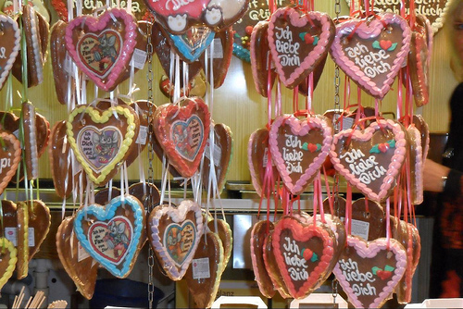
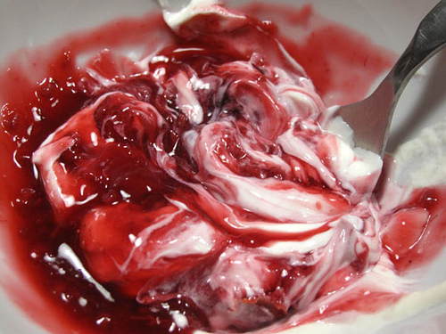
German Puddings!
Sweets
Lebkuchen
Schwarzwälder Kirschtorte
Rote Grütze (red berries)
Served with sahne oder vanilleeis

Slide 11
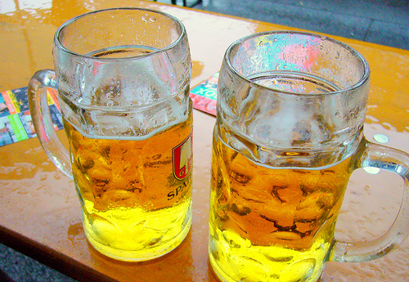
… and German beer - for the grown ups!!

Slide 12
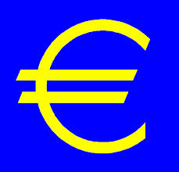
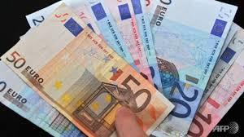
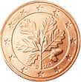
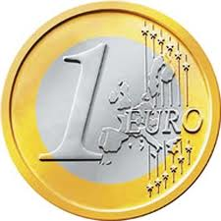
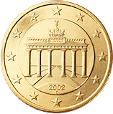
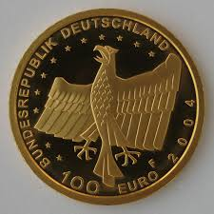
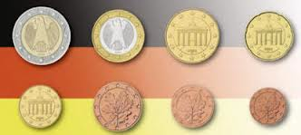
The Euro
Is Germany’s national currency.

Slide 13
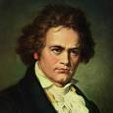
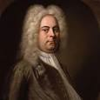
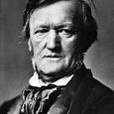
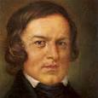
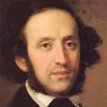
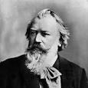
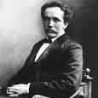
Famous German Composers
Ludwig van Beethoven
1770 -1827
George Frideric Handel
1685 - 1759
Richard Wagner
1813 - 1883
Robert Schumann
1810 -1856
Felix Mendelssohn
1809 -1847
Johannes Brahms
1833 - 1897
Richard Strauss
1864 - 1949

Slide 14

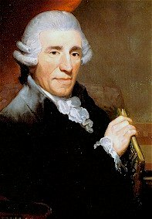
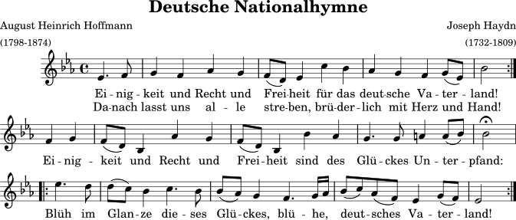

Slide 15
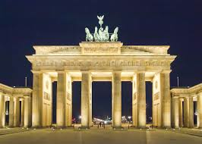
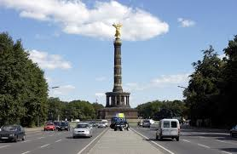
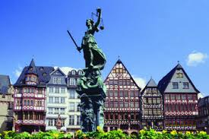
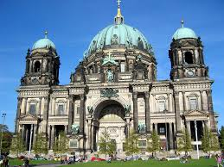
Berlin is Germany’s Capital City. It has 3.5 million inhabitants and is the biggest city.

Slide 16
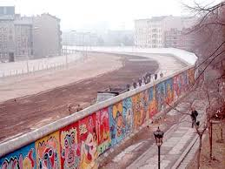
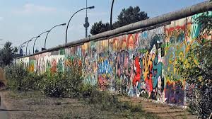
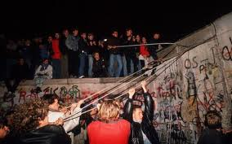
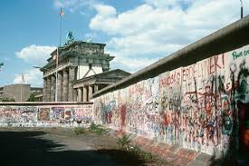
Berlin had a wall running built though it and around it to divide the East from the West
(from 1961 – 1962)
It came down in the winter of 1989 and Eastern and Western Germany were reunited .

Slide 17
Challenge!
Can you say the numbers 1-10 in German?
Do you know your shape names in German?
Can you say the colour names in German?

