Slide 1

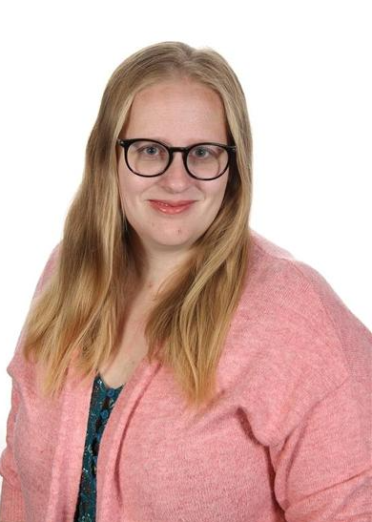
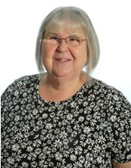
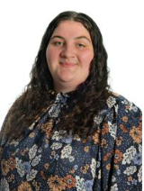
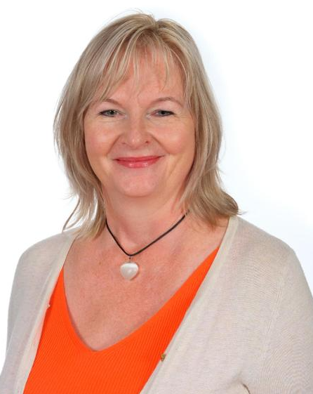
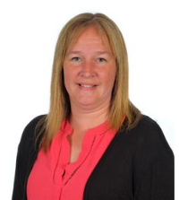
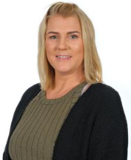
Aiming High, Achieving Together
Y1 Welcome Meeting
Barn Owls
Tawny Owls
Notes:
J: Hello and welcome to Merton Infant School’s Year 1 presentation. My name is Mrs Epstein and I am the class teacher for Tawny Owls.
M: Hello, my name is Mrs Eglin and I am the class teacher for Barn Owls.
We also work with Mrs Darby, Mrs Bond, Miss Hankova, Mrs Cowdrey, and who are our learning support assistants. Although they are based in separate classes, they work with and support children across the year group.

Slide 2
Topics
Topics are started with an exciting launch and end with a landing.
Topics drive the learning and objectives set will match the curriculum subjects.
 | Autumn 1 | Autumn 2 | Spring 1 | Spring 2 | Summer 1 | Summer 2
Topic Launch Landing | Out and About Popley Expedition Posters for Popley | Once Upon a Time Watch Shrek Story Book for school library | We’re on the Move Trip to Brooklands Junk Modelling with parents | Fire! Fire! History Topic Box Fire Safety Workshop | Seasides! Discovery of an old Suitcase Seascape Art Gallery | Amazing Animals Letter from Marwell Zoolab Visit Seasides!
Notes:
M: Each half term, the learning is based around a topic. We launch each topic with an event or discovery to motivate the children to learn and explore. At the end of half term we have a landing to bring all their hard work together. This makes their learning more exciting, purposeful and memorable.
J: In Autumn 1 our topic has a geography focus and we spend time exploring our local area. In Autumn 2 look at the history of transport, particularly how cars have changed over the last 150 years. After Christmas in Spring 1 we look at the events of the Great Fire of London which includes a Fire Safety Workshop from Hampshire Fire & Rescue. Spring 2 is all about fairytales and traditional tales. We retell and write lots of stories as we start to get ready for Year 2.
C: Summer 1 is a science based topic looking at Animals and their habitats. Children also spend time creating patterns and sketches inspired by the animals. Lastly, as the year comes to an end, we combine history and geography to learn about Seasides as an environment, destination and historic holiday tradition.

Slide 3
PE
PE lessons twice a week. Tuesday and Friday
Daily Mile – 15 minutes every day
Wiggle – 15 minutes every day
They will need to wear their colour team t.shirt, black shorts and black tracksuit bottoms including black plimsolls / trainers on the day.
No jewellery. Earrings to be taken out that day or covered up.
Notes:
J: PE lessons occur twice a week and include indoor and outdoor activities. Over the year we will cover dance, gymnastics, yoga, athletics and a range of games skills such as hockey and tennis. During the summer term we are lucky to have a fully qualified football coach from Stow Sports to teach the children. The same coach also runs an afterschool football club which children can attend from September.
C: PE days change every term. The days will be on the curriculum newsletters and on the class web pages. Please ensure children have fully names PE kits in school and any jewellery is removed before coming to school.
M: Physical activity guidelines for children tell us that children and young people aged 5 to 18 should: aim for an average of at least 60 minutes of moderate intensity physical activity a day. 30 minutes of this is required to be delivered in school. This includes playtimes and lunchtime activities but we also participate in a ‘wiggle’ times and daily mile to keep the children active throughout the day.

Slide 4
Assessment
Children are assessed against Age Related Expectations (ARE) for Reading , Writing and Maths. You will be kept informed as to whether they are:
Working Below ARE
Working Towards ARE
Expected Standard
Greater Depth Standard
Specific learning targets are shared at Parents’ Evening in Autumn and Spring.
At the end of the year you will receive an annual report detailing their outcome for all areas of the curriculum.
Some children may require additional support to meet their targets. These children will be placed on the schools Intervention Register or SEN register. Their progress is supported and monitored closely by Mrs James, our inclusion manager/ Headteacher. We will always discuss any support your children may need with you before we add them to the list.
Notes:
C: Children are assessed against Age Related Expectations (ARE) for Reading , Writing and Maths. You will be kept informed as to whether they are: Working Below ARE, Working Towards ARE, Expected Standard or Greater Depth Standard. Specific learning targets are shared at Parents’ Evening in Autumn and Spring. At the end of the year you will receive an annual report detailing their outcome for all areas of the curriculum.
J: Some children may be identified as needing additional support in school for a variety of reasons. Any concerns about your child’s learning will be discussed with you. If a specific learning need is identified, they may be added to the SEN register. Mrs Durbajlo, our Inclusion Manager, works with children, staff and parents to ensure a plan is in place to support those children. This may involve additional small group work with an LSA, known as intervention groups, or close in class support from the class teacher.

Slide 5
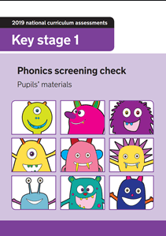
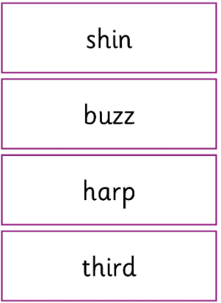
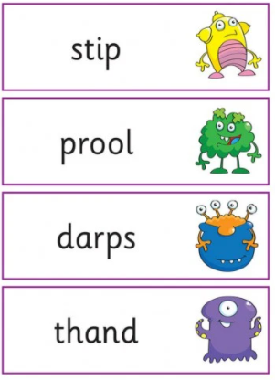
Y1 Phonics Screening
Children will do a Phonic test in June.
It consists of real words and pseudo (made-up) words.
It is 1:1 with their teacher and is presented as a fun activity.
Parents are informed of the test outcome in the children’s end of year annual report. If they do not pass then they have to re-sit a new test in Y2.
Notes:
M: In summer term, Year 1 complete a statutory phonics screening assessment. This identifies the children’s ability to sound out and blend words together in order to read. We introduce this to the children at an early stage in the year with regular games and practise. This way the children are unaware they are taking a test as it is a normal part of their learning. The test consists of 40 words. Some are real and some are pseudo words, known to the children as ‘alien’ words.

Slide 6

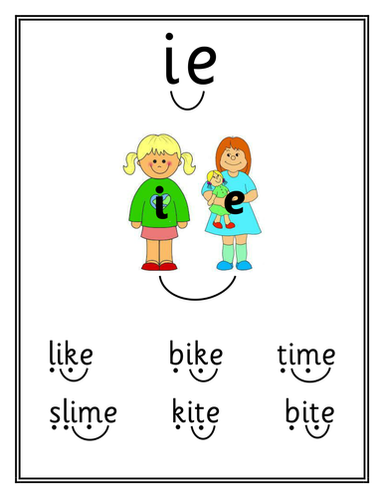
Phonics
Sound buttons – Sausages, beans and spaghetti !
Notes:
J: Children are taught to identify units of sound in words using sound buttons. The single dots are known as ‘beans’ by the children and they show that only 1 letter is making a sound. If a digraph or trigraph is used, which means they need 2 or 3 letters to make a sound, the children draw a ‘sausages.’
M: Some words cannot be decoded using taught phonics sounds as there are exceptions to the rules! The children are taught to read and spell these words using flashcards, spelling practice and keyword practice. These words are stuck in the back of the pink home reading diaries so they can be practised at home.

Slide 7
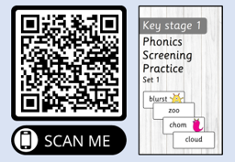

Slide 8
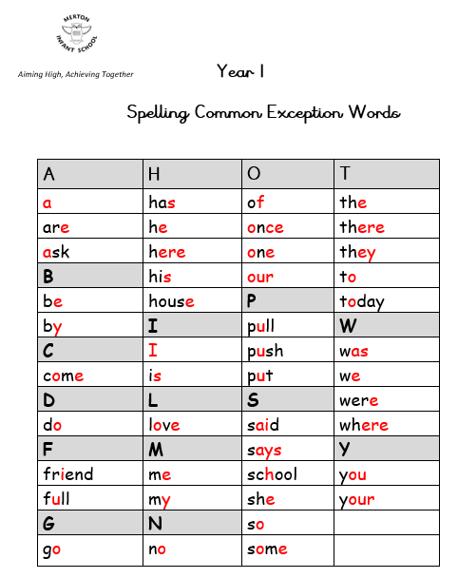
Year 1 Common Exception Words
Notes:
J: Children are taught to identify units of sound in words using sound buttons. The single dots are known as ‘beans’ by the children and they show that only 1 letter is making a sound. If a digraph or trigraph is used, which means they need 2 or 3 letters to make a sound, the children draw a ‘sausages.’
M: Some words cannot be decoded using taught phonics sounds as there are exceptions to the rules! The children are taught to read and spell these words using flashcards, spelling practice and keyword practice. These words are stuck in the back of the pink home reading diaries so they can be practised at home.

Slide 9
Reading
Practice makes perfect!
Children are read with by the Class teacher and LSA twice a week.
Some children may be identified as target readers. These children are read with every day to support their learning. You will always be told if your child is a target reader.
Please write in the pink home reading diaries once you have read with your child each night.
Notes:
C: Each child has a spelling book to practise their weekly spellings. This book stays at home. Please practice spellings every day to prepare for their test on Friday.
J: Children are read with by the Class teacher and LSA twice a week.
Some children may be identified as target readers. These children are read with every day to support their learning. You will always be told if your child is a target reader.
M: You can also log in to Bug Club and Edshed to practise reading and spellings. Let us know what you have been up to by writing in the pink home reading diaries.

Slide 10
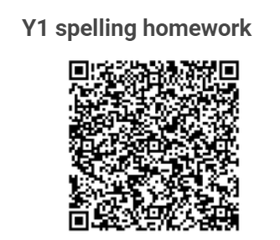
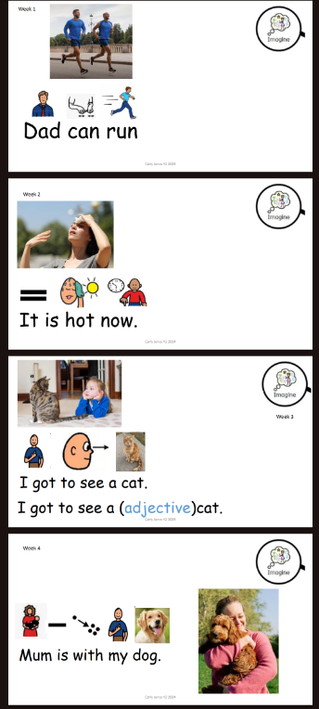
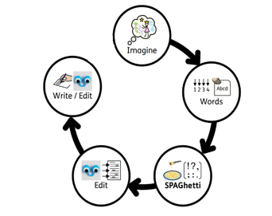
Spellings
Week 1
Notes:
Our Spelling will be split into five steps over the five days. Monday is to Imagine and Internalise, we use the sentence to tell a story. Tuesday is to count the words, identifying the tricky words in the sentence and discussing them. Wednesday is to write the sentence in the air, discussing the difference between an upper and lower case letter, where capital letters should be used and the importance of a full stop. Thursday we use our editing eyes, showing the children three versions of the sentence all with mistakes and the children will discuss the mistakes in talking trios. Then on Friday, the children are going to scribe the sentence in the back of their literacy books as the teacher dictates.

Slide 11
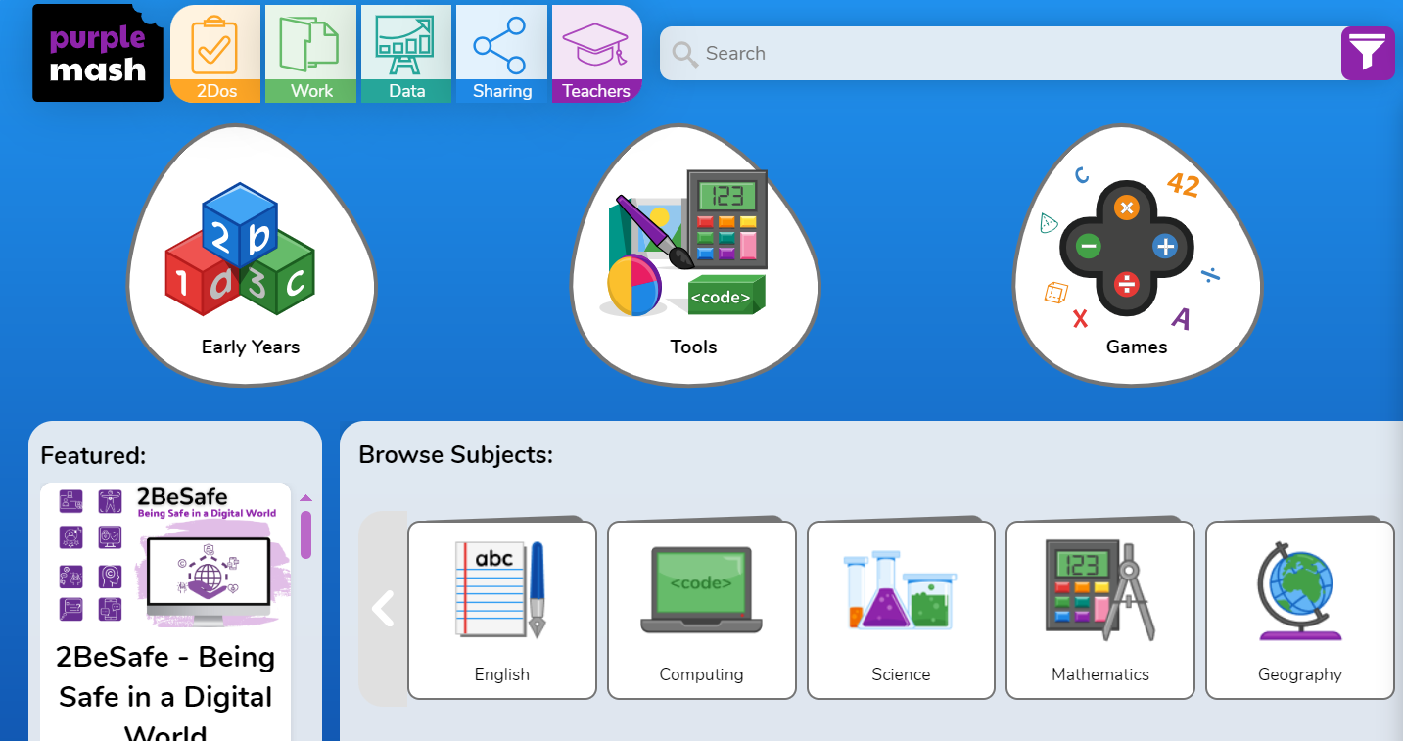

Slide 12

Communication and Information
Class webpages can be found at https://www.mertoninfants.com/
Curriculum newsletters can be found on the website under the class pages every half term.
Any messages for the teachers can be written in the pink home reading diaries to avoid congestion on the school site during drop off and pick up times.
The main school newsletter will be sent as a link over text. Please ensure the office have your current mobile numbers so you can receive text messages.
Notes:
J: Curriculum newsletters are sent home every half term with details or learning in all the curriculum areas. These can also be found on the school website.
Any messages for the teachers can be written in the pink home reading diaries to avoid congestion on the school site during drop off and pick up times.
C: The main school newsletter will be sent as a link over text. Please ensure the office have your current mobile numbers so you can receive text messages.

Slide 13
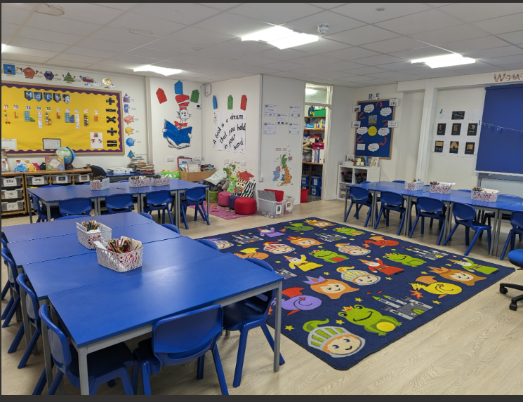
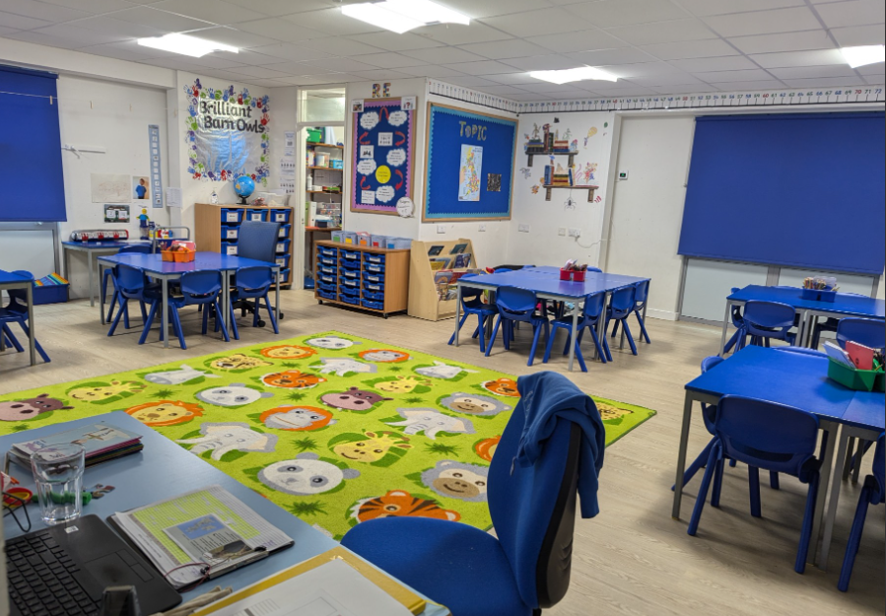
Thank you for watching!
Any questions please contact us at adminoffice@merton-inf.hants.sch.uk
Notes:
C: The Year 1 team have really enjoyed working with the children so far and we are looking forward to watching your children’s progress this year.
R: Any questions please get in touch. Thank you for your continued support.

